Slide 1
Introduction to HPC
Dr Adam Ralph
Mr Prithwish Nandi
UCD, 2018

Slide 2
Content
What is High Performance Computing?
The Fundamentals of Computer & HPC Architectures
Parallel Performance
Parallel Programming Paradigms
Practical

Slide 3
Content
What is High Performance Computing?
The Fundamentals of Computer & HPC Architectures
Parallel Performance
Parallel Programming Paradigms
Practical

Slide 4
What is HPC?
High Performance Computing encompasses a collection of :
powerful hardware systems and faster networks
high/low level libraries and languages
software tools
programming paradigms
which make previously unfeasible calculations possible.
it’s all about SIZE and SPEED!
HPC=Parallel Computing

Slide 5
Why HPC?
HPC can benefit those who wish to
carry out huge amounts of repetitive calculations on large amounts of data
obtain valid results in a reasonable time
HPC supplements traditional scientific and engineering methods by carrying out numerical calculations on real phenomena and/or experiments that are expensive or too dangerous to perform in lab

Slide 6
Why HPC?
… too EXPENSIVE
building a throw-away passenger jet, F1 car
Wind tunnel
… too SLOW
waiting for climate or galactic evolution
earthquake prediction
… too DANGEROUS or CONTROVERSIAL
testing nuclear weapons
construction of atom bombs

Slide 7
Motivation
We continually demand greater computational power
We want to reduce the execution time of our important applications
We want to overcome the limitations of desktop computing architectures

Slide 8
HPC Today
HPC-capable architectures are becoming more accessible, user-friendly and affordable
From small inexpensive clusters with commodity hardware and Unix/Linux OS
To the fastest supercomputers
HPC is being used around the world from large groups to individuals, from research labs to traffic management
Growing demand for computational power
Engineering, physics, chemistry, biology, finance, social sciences

Slide 9
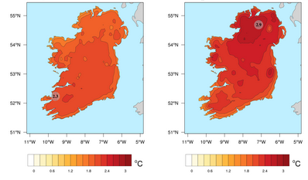
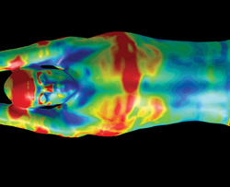
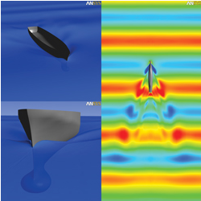
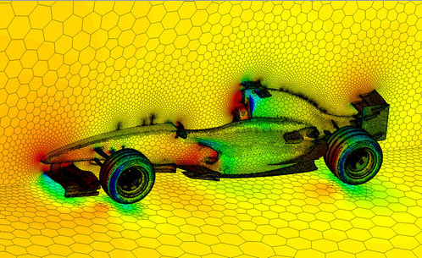
Where is used?
Simulation showing temperatures of top 5% of summer highest daytime and the lowest 5% of winter nighttime
Swimsuit design to reduce drag based on fluid flow analysis
Model of the wave formulation around a seafaring vessel
Polyhedral mesh and pressure distribution on an F1 car
Model of the production and assembly of Pringles and Pampers Nappies

Slide 10
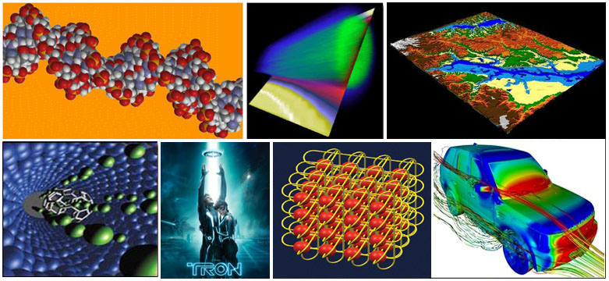
Where is used?

Slide 11

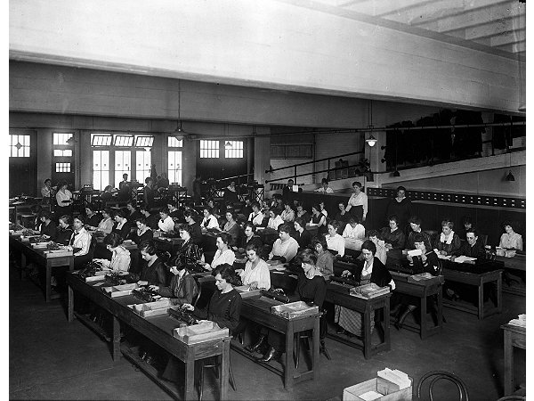
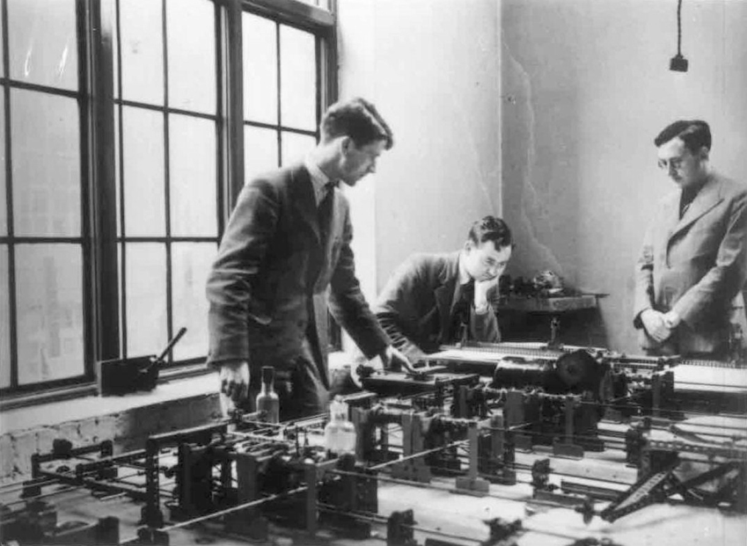
History of HPC
ENIAC… computing ballistic tables (July 1946 – Oct 1955)
ENIAC
Computers
Meccano
Notes:
Electronic Numerical Integrator and Computer
Glen Beck (background) and Betty Snyder (foreground) program ENIAC in BRL building 328. (U.S. Army photo)
MOTAT's Meccano differential analyser in use at the Cambridge University Mathematics Laboratory, c. 1937. The person on the right is Dr Maurice Wilkes, who was in charge of it at the time
Women at work tabulating during World War II (Shorpy)

Slide 12
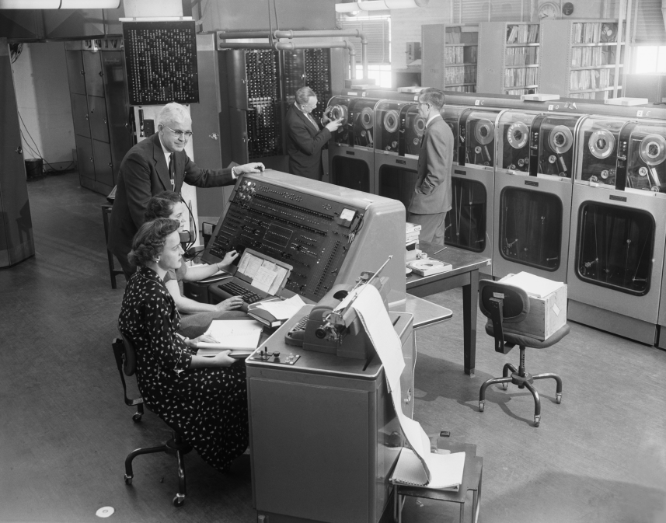
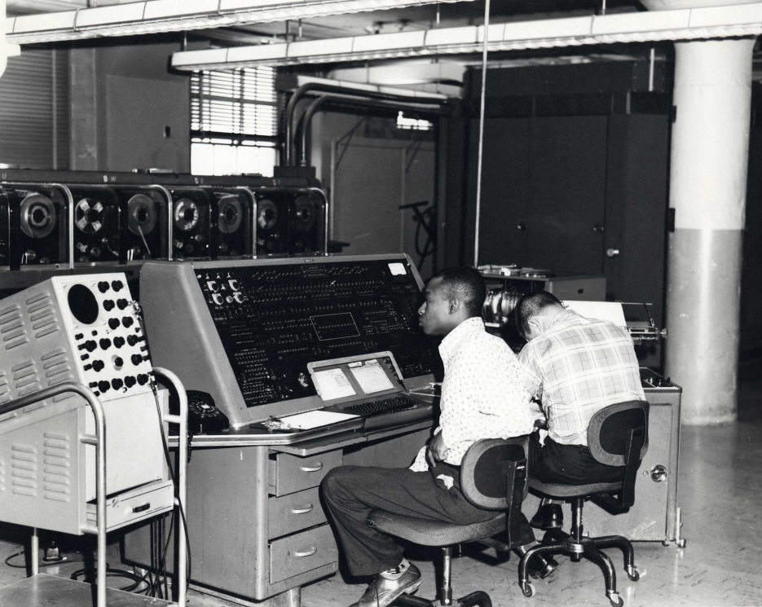
History of HPC
UNIVAC 1950s; less than 50 made
US Census processing
Army usage
Use to predict 1952 US elections results
Corporations
Notes:
UNIVersal Automatic Computer
Two expensive to be bought by universities few were donated by UNIVAC makers… speed of the machine was 1905operations/s. More or less at the same time MARK 1 was built at University of Manchester in UK.

Slide 13
History of HPC
1960s: Scalar processor
Process one data item at a time
1970s: Vector (Array) processor
Can process an array of data items at a time
Later 1980s: Massively Parallel Processing (MPP)
Up to thousands of processors, each with its own memory
Later 1990s: Cluster
computers connected together with a network and centrally coordinated by some special software; physically close
Later 1990s: Grid
collaboration among geographically distributed organisations
Later 2000s:Accelerators
GPUs, FPGAs, Xeon Phis

Slide 14
Getting into HPC
Understanding of:
Hardware/architectures
CPU, memory, interconnect, I/O
Software
Programming paradigms, performance considerations
Numerical libraries, I/O libraries
Applications and Tools

Slide 15
Content
What is High Performance Computing?
The Fundamentals of Computer & HPC Architectures
Parallel Performance
Parallel Programming Paradigms
Practical

Slide 16

von Neumann Architecture
Four main components:
Memory
Control Unit
Arithmetic Logic Unit
Input/Output
First draft of a report on EDVAC, 1945,
http://goo.gl/DnWs3t
Memory
CPU
Control
Unit
Arithmetic
Logic Unit
Input
Output
Notes:
Read/write, random access memory is used to store both program instructions and data
Program instructions are coded data which tell the computer to do something
Data is simply information to be used by the program
Control unit fetches instructions/data from memory, decodes the instructions and then sequentially coordinates operations to accomplish the programmed task.
Aritmetic Unit performs basic arithmetic operations
Input/Output is the interface to the human operator

Slide 17
Basic Concepts
PROCESS: is a task being run by a computer, often simultaneously with many other tasks each taking turns on a single central processing unit;
CPU (Central Processing Unit): single- or multi-core chips that can handle multiple processes;
CU: Schedules the order of
Instruction execution
ALU: Performs arithmetic
and logical calculations
FPU: Performs operations on
floating point numbers; available
in many modern processors
RAM
BIU
L2 Cache
L1 Instruction Cache
Control Unit
Execution Unit
ALU
FPU
…
Registers
L1 Data Cache

Slide 18
Basic Concepts
REGISTER: small amount of storage where data resides that is being used right now;
CACHE: small area of fast memory where data resides when it is about to be used and/or has been used recently;
MAIN MEMORY (also called RAM “Random Access Memory”): where data resides when it is being used by a program that is currently running. It may be volatile or not.

Slide 19
Memory Hierarchy
CPU
Cache
L1 Cache
Physical Memory Random Access Memory
L2 Cache
L3 Cache
Solid State Memory Non-volatile flash based memory
Virtual Memory File Based Memory
Registers
Super Fast, Super Expensive, Tiny Capacity
Processor
Faster, Expensive,
Small Capacity
SDRAM DDR3L, DDR3 RDRAM,EDO,SDRAM
Fast, Reasonable Average Capacity
Average Speed
Reasonable
Good capacity
SSD, Flash
HDD
Slow
Cheap
Large

Slide 20
Memory Hierarchy
Typical access times and sizes:
Cache Hit: requested data found in cache, fast access.
Cache Miss: requested not found in cache, need to access lower memory levels, slower access
Level | Speed | Size
Register, L1 | 1 ns | KB
L2, L3 | 10 ns | MB
Main Memory | 100 ns | GB
Disk | 10 ms | TB
Tape | 10 s | PB

Slide 21
Flynn Taxonomy
Single Instruction Single Data (SISD): at any one time only a single instruction is executed, operating on a single data item.
Control Unit
CU
Is
Processing Unit
PE
Ds
Main Memory
MM
Is

Slide 22
Flynn Taxonomy
Single Instruction Multiple Data (SIMD): multiple processors, each operating on its own data item, but they are all executing the same instruction on that data item
PE1
Ds1
MM1
MM2
MMn
Control Unit
CU
Is
Ds2
PE2
Dsn
PEn
Is

Slide 23
Flynn Taxonomy
Multiple Instructions Single Data (MISD): All processors do different operations on the same data
Is1
PE1
Ds
MM
CU1
Ds
Is2
PE2
CU2
Ds
CUn
Isn
PEn
Ds
Isn
Is2
Is1

Slide 24
Flynn Taxonomy
Multiple Instructions Multiple Data (MIMD): multiple CPUs operate on multiple data items, each executing independent instructions
Is1
PE1
Ds1
MM
CU1
Is2
PE2
Ds2
CU2
CUn
Isn
PEn
Dsn
Isn
Is2
Is1

Slide 25
Shared Memory
CPU
CPU
CPU
CPU
Cache
Cache
Cache
Cache
Main Memory
I/O
System

Slide 26
Shared Memory
UMA (Uniform Memory Access), SMP (Symmetric Multi-Processing)
The latency to access any address in the logical memory space is the same for each CPU.
NUMA (Non-Uniform Memory Access)
The latency to access any address in the logical memory space is determined by the physical distance from the CPU.
Cache-Coherency (cc)
To ensure cache consistency (i.e. local cache has the most up-to-date copy of a shared memory resource), cache-coherency protocols are implemented on modern systems.

Slide 27
Shared Memory
ADVANTAGES:
Global address space provides a user-friendly programming perspective to memory (such as with the OpenMP API)
Data sharing between tasks is both fast and uniform due to the proximity of memory to the CPUs
DISADVANTAGES:
Need for cache-coherency
Lack of scalability between memory and CPUs. Adding more CPUs can geometrically increase traffic on the shared memory-CPU path, and for cache coherent systems, geometrically increase traffic associated with cache/memory management.
Programmer responsibility for synchronization constructs that ensure "correct" access of global memory (i.e. prevent race conditions)

Slide 28
Distributed Memory
CPU
Cache
CPU
Cache
CPU
Cache
Memory
I/O
Memory
I/O
Memory
I/O
Interconnection Network
Memory
I/O
Memory
I/O
Memory
I/O
CPU
Cache
CPU
Cache
CPU
Cache

Slide 29
Distributed Memory
bus
line
2D mesh
hypercube
fully connected
Topology | Degree | Diameter | Avg. dist. | Bisection | Tot. BW (links)
bus | 1 | 1 | 1 | 1 | 1
line | 2 | N-1 | N/2 | 1 | N-1
2D mesh | 4 | 2*(N^{1/2}-1) | 2N^{1/2}/3 | N | 2N-2
hypercube 2-cube | log₂N | log₂N | log₂N/2 | N/2 | N/(2 log₂N)
fully Connected | N-1 | 1 | 1 | N²/4 | N(N-1)/2
The choice of the interconnection has a strong impacts of the communication performance
Notes:
Degree: number of neighbours; diameter : longest path; bisection: if split in half how many connections between each half.
N is number of nodes e.g. 16 for planar mesh. The hyper cube must have 2^{n} node

Slide 30
Distributed Memory
ADVANTAGES:
Memory is scalable with number of processors. The number of processors and the size of memory increases proportionately.
Each processor can rapidly access its own memory without interference and without the overhead incurred with trying to maintain cache coherency.
Cost effectiveness: can use commodity, off-the-shelf processors and networking.
DISADVANTAGES:
Programmer is responsible for mapping data structures across processors
Programmer is responsible for coordinating communication between nodes when remote data is required in a local computation (called message-passing)
Access to remote memory is significantly slower than to local memory
Currently, only low-level programming API’s (such as MPI) are available to perform message-passing
Notes:
Do not need cache coherency because variables are private to each MPI process.

Slide 31
Distributed-Shared Memory
CPU
cache
CPU
cache
CPU
cache
CPU
cache
CPU
cache
CPU
cache
CPU
cache
CPU
cache
CPU
cache
CPU
cache
CPU
cache
CPU
cache
…
…
…
Memory
I/O
Memory
I/O
Memory
I/O
Interconnection Network
Memory
I/O
Memory
I/O
Memory
I/O
…
…
…
CPU
cache
CPU
cache
CPU
cache
CPU
cache
CPU
cache
CPU
cache
CPU
cache
CPU
cache
CPU
cache
CPU
cache
CPU
cache
CPU
cache

Slide 32
Distributed-Shared Memory
ADVANTAGES:
Exploits the advantages of both shared and distributed-memory architectures at different levels.
Can exploit both shared and distributed-memory programming paradigms (OpenMP and MPI) to solve difficult tasks
DISADVANTAGES:
The same disadvantaged of a pure Shared Memory system
The same disadvantaged of a simple Distributed system

Slide 33
Heterogeneous Systems
Memory
CPU
cache
CPU
cache
Memory
CPU
cache
CPU
cache
Memory
CPU
cache
CPU
cache
CPU
cache
CPU
cache
CPU
cache
CPU
cache
CPU
cache
CPU
cache
…
…
…
I/O
I/O
I/O
Acc
Acc
Acc
Acc
Acc
Acc
Interconnection Network
Acc
Acc
Acc
Acc
Acc
Acc
I/O
I/O
I/O
Memory
…
Memory
…
Memory
…
CPU
cache
CPU
cache
CPU
cache
CPU
cache
CPU
cache
CPU
cache
CPU
cache
CPU
cache
CPU
cache
CPU
cache
CPU
cache
CPU
cache

Slide 34
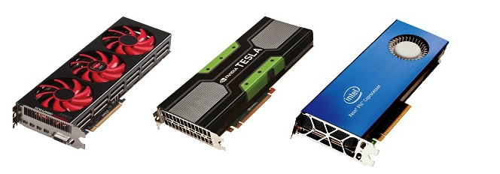
Heterogeneous Systems
Examples: AMD GPUs, NVIDIA GPUs, Xeon Phi Coprocessors
high-performance many-core processors that can be used to accelerate a wide range of applications
Offload the computationally intensive part
Massive number of floating point units
Single Instruction Multiple Threading (SIMT): Enable many more threads to execute the same instruction simultaneously

Slide 35
Heterogeneous Systems
ADVANTAGES:
Accelerators can speed-up the calculation
DISADVANTAGES:
Accelerators are separated from the system (like a PCI card), they do not share the memory with the host system;
Accelerators require their own programming environment.

Slide 36
Content
What is High Performance Computing?
The Fundamentals of Computer & HPC Architectures
Parallel Performance
Parallel Programming Paradigms
Practical

Slide 37
Basic Concepts
FLOP: Floating Point Operation (addition, multiplication, square root, and so on)
FLOP/sec, FLOP/s, FLOPS: a common performance metric
FLOPS units
megaFLOPS (MFLOPS) 10^6
gigaFLOPS (GFLOPS) 10^9 single CPU performance
teraFLOPS (TFLOPS) 10^12 small-middle scaled supercomputers
petaFLOPS (PFLOPS) 10^15 we are here right now
exaFLOPS (EFLOPS) 10^18 the next milestone
The most powerful supercomputers nowadays operate in petaFLOPS range (one quadrillion calculations per sec)

Slide 38
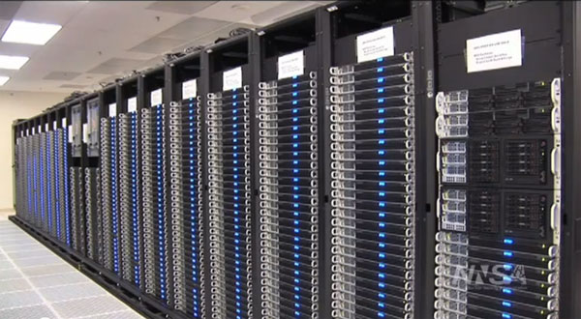
Basic concepts
Peak Performance:
The theoretical maximum performance
Little indication on how the system will perform in practice, can never be reached.
[max # FLOPs per cycle] × clock rate [Hz] × # cores × # sockets × # nodes
Terminology:
The cores perform FLOPs.
A core can do a certain number of FLOPs
every time its internal clock ticks. These ticks
are called cycles and measured in Hertz (Hz).
A processor contains one or more cores.
A socket holds one processor.
A node contains one or more sockets.
A "chassis" houses one or more nodes.

Slide 39
www.top500.org
Since 1993 parallel machine performance has been measured and recorded with the LINPACK benchmark (dense linear algebra, Ax=b). Latest November 2016.
Rank | Site | Country | System | Core | Rmax (TFlops) | Rpeak (TFlops) | Power (kW)
1 | National Supercomputing Centre in Wuxi | China | Sunway TaihuLight NRCPC | 10,649,600 | 93,014.6 | 125,435,9 | 15,371
2 | National Super Computer Center in Guangzhou | China | Tianhe-2 (MilkyWay-2), NUDAT | 3,120,000 | 33,862.7 | 54,902.4 | 17,808
3 | DOE/SC/Oak Ridge National Laboratory | USA | Titan - Cray XK7, Cray | 560,640 | 17,590.0 | 27,112.5 | 8,209
4 | DOE/NNSA/LLNL | USA | Sequoia – BlueGene/Q IBM | 1,572,864 | 17,173.2 | 20,132.7 | 7,890
5 | DOE/SC/LBNL/NERSC | USA | Cori – Cray XC40, Cray | 622,336 | 14,014.7 | 27,880.7 | 3,939
6 | Joint Centre for Advanced High Performance Computing | Japan | Oakforest-PACS-PRIMERGY, Fujitsu | 556,104 | 13,554.6 | 13,554.6 | 2,719
Rmax – maximal LINPACK performance
Rpeak – theoretical peak performance, assuming linear scaling.

Slide 40
www.green500.org
Since 2007; Metric: MFLOPS per Watt, List from November 2016
Rank | Site | Country | System | MFlops/W | Power (kW)
1 | NVIDIA Corp | US (probably) | NVIDIA DGX-1 | 9462.1 | 349.5
2 | Swiss National Supercomputing Centre | Switzerland | Cray XC50 | 7453.5 | 1312
3 | Advanced Centre for Compting, RIKEN | Japan | ZettaSclaer-1.6 | 6673.8 | 150.0
4 | National Supercomputing Centre, Wuxi | China | Sunway MPP | 6051.3 | 15371
5 | Fujitsu GmbH | Germany | PRIMERGY CX1640 | 5806.3 | 77.0
6 | Joint Centre for Advanced High Performance Computing | Japan | PRIMERGY CX1640 | 4985.7 | 2718.7
You can see that some of the biggest machines are also very energy efficient

Slide 41
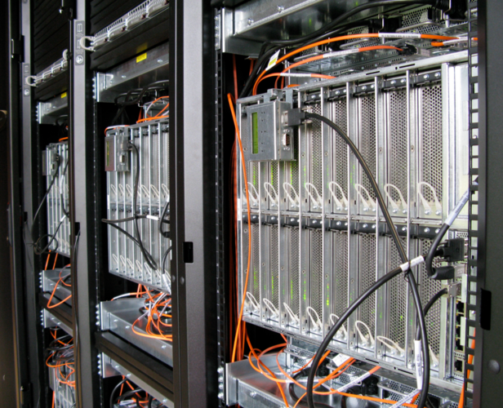
Fionn
Example: (Fionn ICE X)
320 compute nodes (7680 cores)
2 Intel Ivy Bridge processors, 2 sockets
Clock speed: 2.4 GHz
Each core can perform 8 Flops in each clock cycle
8 FLOPs × 12 cores × 2 sockets × 2.4 GHz x 320 nodes ~ 150 TFLOPS

Slide 42


Speedup
The goal of speedup is to use P processors to solve a problem P times faster
Relative Speedup: compare the same (parallel) algorithm on one and multi-processor system
Absolute Speedup: best sequential algorithm for the one processor system is compared to the best parallel algorithm for the multi-processor system

Slide 43
Speedup
The execution time depends on what the program does!
A parallel program spends time in:
Work
Synchronization
Communication
Extra work (overheads)
A program implemented for a parallel machine is likely to do extra work (than a sequential program) even when running in a single processor machine!

Slide 44
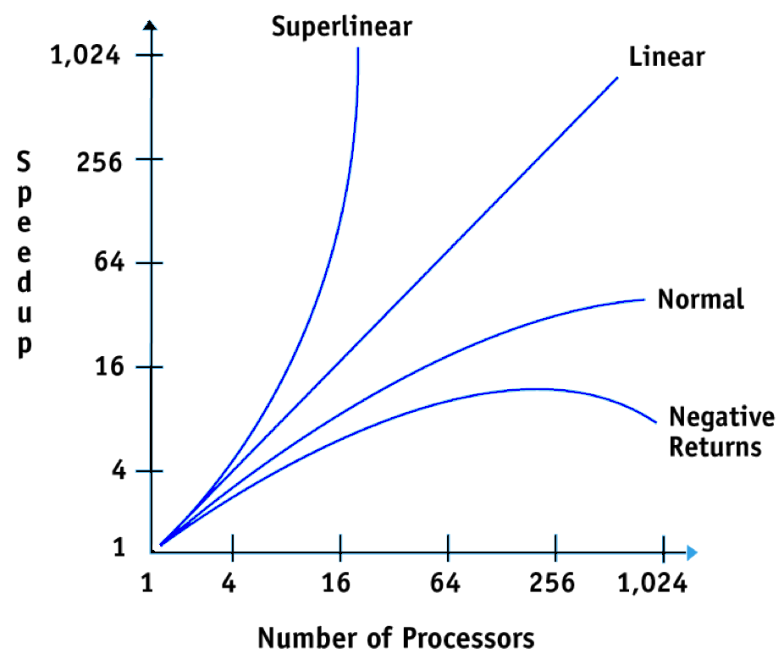
Speedup

Slide 45
Super Linear speedup
Sometimes P processors can achieve a speedup > P
usually the result of improving an inferior sequential algorithm
can legitimately occur because of cache and memory effects
More processors typically also provide more memory/cache
Total computation time decreases due to more page/cache hits

Slide 46

Limits to speedup
If I use two processors, shouldn’t my program run twice as fast?
The speedup of a program using multiple processors in parallel computing is limited by the sequential fraction of the program.
Amdahl's Law: Let f be the fraction of operations in a computation that must be performed sequentially, where 0<=f<=1. The maximum speedup achievable by a parallel computer with p processor:

Slide 47
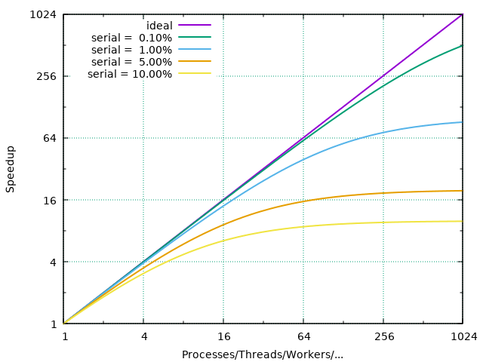
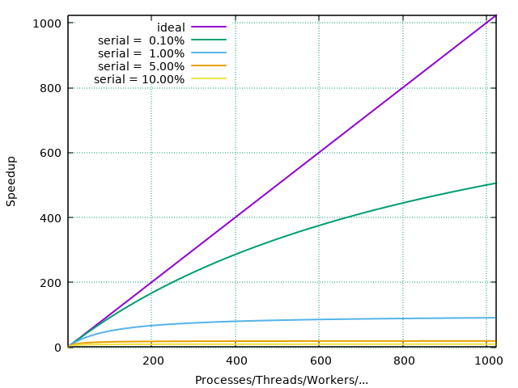
Amdahl’s Law
Notes:
Upper left graph is log scale, lower right linear. Shows that even with perfect scaling, serial sections kill speedup.

Slide 48
Limits to speedup
Serial sections limit the parallel performance
Parallel Overhead: the time required to coordinate parallel tasks and communicate information between processors
cost of starting a thread or process
cost of communicating shared data
cost of synchronizing
cost of extra (redundant) computation
…the effort expended on achieving high parallel processing rates is wasted unless it is accompanied by achievements in sequential processing rates of very nearly the same magnitude. — Gene Amdahl

Slide 49


Efficiency
how well-utilized the processors are in solving the problem, compared to how much effort is wasted in communication and synchronization
E(p)<=1
E(p)=1 if there is linear speedup

Slide 50
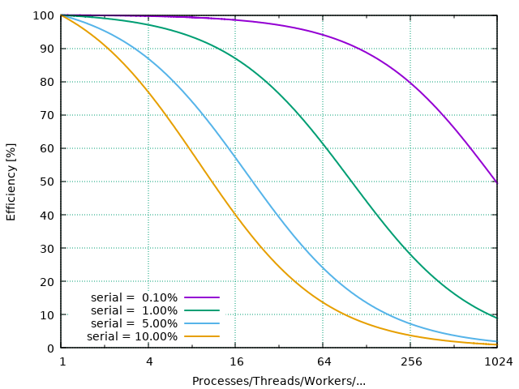
Efficiency

Slide 51
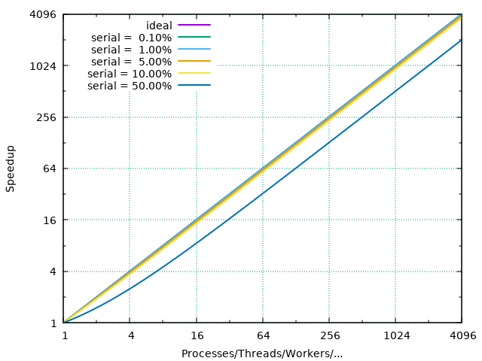
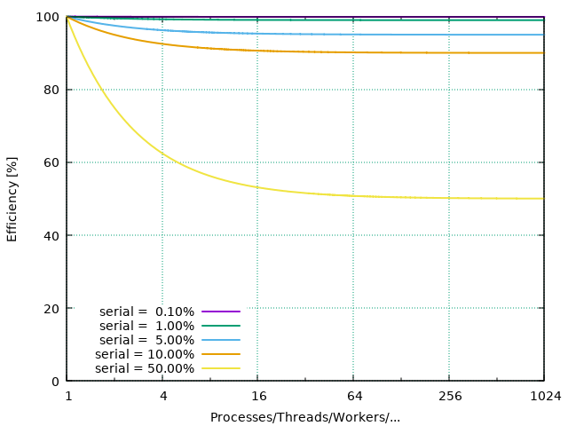
Gustafson-Barsis’ Law
…speedup should be measured by scaling the problem to the number of processors, not by fixing the problem size. — John Gustafson
S(f,p)=f+(1-f)p

Slide 52
Scalability
The performance when the size of the problem or the number of processors changed.
Assume a problem of size N using P processors takes time T
Strong Scaling: As N remains fixed, kP processors solve the problem in T/k time.
Weak Scaling: For a problem of size kN, kP processors solve the problem in time T.
http://goo.gl/Z5QxSn

Slide 53

Communication
For some problems, increasing the number of processors will:
Decrease execution time attributable to computation
May increase execution time attributable to communication
Time required for communication is dependent upon system communication bandwidth parameters.
The time (T) required to send W words between any two processors is given by:
where
L = Latency: the fastest time in which a single byte can be sent
B = Bandwidth: how much data can be sent per unit time

Slide 54
Parallel performance factors
Performance
Synchronizations
Data Dependencies
Communication Patterns
Granularity
Load Balancing

Slide 55
Content
What is High Performance Computing?
The Fundamentals of Computer & HPC Architectures
Parallel Performance
Parallel Programming Paradigms
Practical

Slide 56

Why Parallelisation?
Parallelism means doing multiple things at the same time
→ you can get more work done in the same time.

Slide 57
Serial vs parallel
Serial (Sequential) Programming: Problem is broken into a discrete series of instructions. They are executed one after another.
Parallel Programming: Problem is broken into discrete parts. Each part is broken into a series of instructions. Instructions are executed simultaneously on different CPUs but one after another within one CPU.
Write the best serial code and decide if it requires parallelization

Slide 58
Types of Parallelism
Data Parallelism: Independent tasks applying the same operation to different elements of a data set
Functional (Task) Parallelism: Independent tasks applying different operations to different data elements
Pipelining: A set of data processing elements connected in series. The output of one is the input of the next
from i=0 to i=99
c[i]=a[i]+b[i]
Calculate a and b
x=(a+b)/2
y=(a-b)/2
a[0]=temp
from i=1 to i=n
a[i]=a[i-1]+temp

Slide 59
Basic Idea
Parallel processing
Pipelined processing
time
time
P1
a1
a2
a3
a4
P1
a1
b1
c1
d1
P2
b1
b2
b3
b4
P2
a2
b2
c2
d2
P3
c1
c2
c3
c4
P3
a3
b3
c3
d3
P4
d1
d2
d3
d4
P4
a4
b4
c4
d4
Less inter-process communication
Complicated processor hardware
More inter-process communication
Simpler processor hardware
Colours: different types of operations performed
a, b, c, d: different data streams

Slide 60
Data dependence
Parallel processing requires NO data dependence between processes
Pipelined processing will involve inter-process communication
time
time
P1
P1
P2
P2
P3
P3
P4
P4

Slide 61
Foster’s Design Methodology
Problem
Partitioning
Communication
Primitive tasks
Agglomeration
Mapping
Notes:
Next slides explain the above

Slide 62
Partitioning
Dividing computation and data into pieces
Domain decomposition
Divide data into pieces
Determine how to associate computations with the data
Functional decomposition
Divide computation into pieces
Determine how to associate data with the computations

Slide 63
Communication
Determine values passed among tasks
Local communication
Task needs values from a small number of other tasks
Create channels illustrating data flow
Global communication
Significant number of tasks contribute data to perform a computation
Don’t create channels for them early in design
Minimize communication so as not to dominate computation

Slide 64
Agglomeration
Grouping tasks into larger tasks
Goals
Improve performance
Maintain scalability
of program
Simplify programming
Eliminate communication between primitive tasks agglomerated into consolidated task. Combine groups of sending and receiving tasks.

Slide 65
Mapping
Process of assigning tasks to processes
Goals of mapping
Maximize processor utilization
Minimize inter-processes communication
2
3
2
0
3
1
5
7
1
5
6
6
4
4
8
8
7
0
P0
P1
P2

Slide 66
Parallelisation Strategies
Automatic
Compiler can analyze serial loops for potential parallel execution
Compiler Directives
Help compiler determine which parts to parallelized and how
Message Passing
Two sided, send and receive communication between processes
Using Parallel Libraries
A large collection of functions that can benefit applications and provide immediate performance.

Slide 67
Shared Memory
Master thread
Advantages:
The notion of data ownership is lacking, so there is no need to specify explicitly the communication of data between tasks
Program development can often be simplified
Example: OpenMP
Fork-join Model
Parallel
Threads
Computation
End Parallel
Master thread

Slide 68
OpenMP Example C
double dot(double *A,double *B, int n)
{
int i;
double s=0.0d;
#pragma omp parallel for reduction(+:s), shared(A,B), private(i)
for(i=0; i<n; ++i) {
s+=A[i]*B[i];
}
return s;
}

Slide 69
OpenMP Example Fortran
real(kind=8) function dot(a,b,n)
real(kind=8), intent(in) :: a(:),b(:)
integer, intent(in) :: n
integer :: i
real(kind=8) :: s
s=0.0_8
!$omp parallel do reduction(+:s), shared(A,B), private(i)
do i=1,n
s=s+a(i)*b(i)
end do
!$omp end parallel do
dot=s
end function dot

Slide 70
Distributed Memory Programming
The message passing model demonstrates the following characteristics:
A set of processors that use their own local memory during computation.
Processors exchange data through communications by sending and receiving messages.
Data transfer usually requires cooperative operations to be performed by each process. For example, a send operation must have a matching receive operation.
Example: MPI

Slide 71
Send/Receive
process
process
send (Y)
receive (Y)
Y
Y
message(Y)

Slide 72
MPI Example C
int main(int argc, char **argv) {
float buffer[10];
int ierr, rank, sendto, tag;
MPI_Status stat;
ierr = MPI_init(&argc, &argv);
ierr = MPI_comm_rank(MPI_COMM_WORLD,&rank);
if (rank == 0) {
sendto = 1;
ierr = MPI_send(buf,10,MPI_FLOAT,sendto,tag,MPI_COMM_WORLD);
} else {
recfrom=0;
ierr = MPI_recv(buf,10,MPI_FLOAT,recfrom,tag,MPI_COMM_WORLD,&stat);
}
ierr = MPI_finalize();
}

Slide 73
MPI Example Fortran
Program SendEx
use omp_lib
real(kind=4) :: buffer(10)
integer :: ierr, rank, sendto, tag, stat(MPI_STATUE_SIZE)
call MPI_init(ierr)
call MPI_comm_rank(MPI_COMM_WORLD,rank,ierr)
if (rank .eq. 0) then
sendto = 1
call MPI_send(buf,10,MPI_REAL4,sendto,tag,MPI_COMM_WORLD,ierr)
else
recfrom=0
call MPI_recv(buf,10,MPI_REAL4,recfrom,tag,MPI_COMM_WORLD,stat,ierr)
endif
call MPI_finalize(ierr)
end program SendEx

Slide 74
Content
What is High Performance Computing?
The Fundamentals of Computer & HPC Architectures
Parallel Performance
Parallel Programming Paradigms
Practical

Slide 75
Practical
Logging in, transferring files
Batch queuing system
Running jobs
Compiling, optimisation flags, libraries
General Policies

Slide 76
Fionn
Users login to head node (fionn1,fionn2,fionn3).
Compute intensive jobs are sent to backend nodes, via batch queues.
User must state what resources each job needs and scheduler will manage your job plus all others.

Slide 77
Job Management
Script can be called by any name (convention is .sh/.sub/.pbs, e.g. script.pbs).
they are shell scripts on steroids (sh/bash)
Command to submit a job: qsub script.pbs
Command to cancel/delete a job: qdel <job_id>

Slide 78
Job Monitoring
List of all jobs that are running/queued/blocked: showq (all jobs) showq -r (all running jobs) showq -u <userid> (jobs of userid)
Information on specific jobs: qstat -f <jobid> (info on specific job) qutil -u <userid> (useful, with rough estimate of resource usage)

Slide 79
Module system
Manages software tools/packages (including compilers, libraries) on ICHEC systems.
Common commands: module avail module load <module_name> module list module unload <module_name>
More info: https://www.ichec.ie/support/documentation/

Slide 80
Compilers
Commonly-used parallel programming languages: C, C++, Fortran (77 & 90).
Language | Intel Comp | MPI (Fionn)
C | icc | mpiicc
C++ | icpc | mpiicpc
Fortran77 | ifort | mpiifort
Fortran90 | ifort | mpiifort
Language | GNU Comp | MPI (Fionn)
C | gcc | mpicc
C++ | g++ | mpicxx
Fortran77 | gfortran | mpif90
Fortran90 | gfortran | mpif90

Slide 81
Compiling with Optimisation Flags
-O[n] | Optimise the program for speed (at different levels: [n]=1/2/3). Costs: longer compilation time, larger compiled binary.
-O0 | All optimisations are explicitly disabled. Useful during application development and debugging.
-O1 | Optimise for speed but disable some optimisations which increase code size.
-O2 | Default for Intel compilers and equivalent to specifying -O. Creates the fastest code in most cases (generally recommended).
-O3 | High-level optimisations. Includes O2 optimisations, plus more aggressive ones. May not improve, or even reduce, performance over -O2.

Slide 82
Intel MKL: Routines
LAPACK (solvers and eigensolvers)
BLAS – Level 1,2,3 (vector, vector-matrix, matrix-matrix operations), Sparse BLAS
Multidimensional fast Fourier transforms (FFTs)
Iterative and optimisation solvers
Vector Math Library (VML) transcendental functions
Vector Statistical Library (VSL) functions

Slide 83
End

Slide 84
Scheduling Policy - Fionn
Queue | Job Size (Cores) | Maximum walltime in h | Maximum Available Cores
DevQ | 24-96 | 0.5 | 192
ShortQ | 24-1032 | 24 | 6912
ProdQ | 24-1032 | 72 | 6912
LongQ | 24 | 144 | 768
ShmemQ | 8-112 | 48 | 112
GpuQ | 20-160 | 48 | 320
PhiQ | 20-160 | 48 | 320

Slide 85
Scheduling policy
Don’t specify a queue explicitly in the PBS script.
On Fionn processing cores are allocated in multiples of 24 (24 cores per node)
Don’t flood the system with jobs!
Jobs gain priority at different rates depending on many factors (use showstart <job_id> as a very very rough estimate of when your job is due to start)

Slide 86
Compiling
 | Language | Command | Modules
Sequential | C | icc | dev intel/2015-u1
 | C++ | icpc | “ ”
 | Fortran77 | ifort | “ ”
 | Fortran90 | ifort | “ ”
MPI | C | mpiicc | “ ”
 | C++ | mpiicpc | “ ”
 | Fortran77 | mpiifort | “ ”
 | Fortran90 | mpiifort | “ ”
Example:
$ module load dev intel/2013-sp1
$ icc -o myprog myprog.c
$ mpiicc -o myprog myprog.c

Slide 87
Storage Quota
Place personal files, source codes, etc. in home directory (lower quota).
Large datasets, output from jobs, etc. should be stored in the project directory.
Users are responsible for own backups. (ICHEC only do backups for disaster recovery and there is no guarantee!).

Slide 88
Numerical Libraries
Intel MKL (Math Kernel Library) Provides mathematical routines for scientific and engineering applications.
Routines highly optimised for performance on Intel processors.
https://software.intel.com/en-us/intel-mkl

Slide 89
Practical Session
Let us begin!
ssh –X ph5xxYY@fionn.ichec.ie
YY=01-20
Password:blindorangeseaotter
Change password: passwd

Slide 90
Storage Quota
Soft & hard limits are placed on disk space usage by each user/project.
quota …checks quota usage of home directory… (e.g. /ichec/home/users/jdoe)
quota -g <project_code> …checks quota usage of project directory… (e.g. /ichec/work/dclif000a)

Slide 91
Timers
Precede a command line with time leads to timing of program execution, yielding the following information:
User time: time spent in user mode
System time: time spent in kernel mode
Real time: actual (wallclock) time
System + User time = CPU time

Slide 92
Timers in code
 | C / C++ | Fortran
Generic | clock() gettimeofday() | system_clock cpu_time (Fortran 95)
MPI | MPI_Wtime() | Mpi_wtime
OpenMP | omp_get_wtime() | Omp_get_wtime()
Intel MKL | dsecnd() | dsecnd()

Slide 93
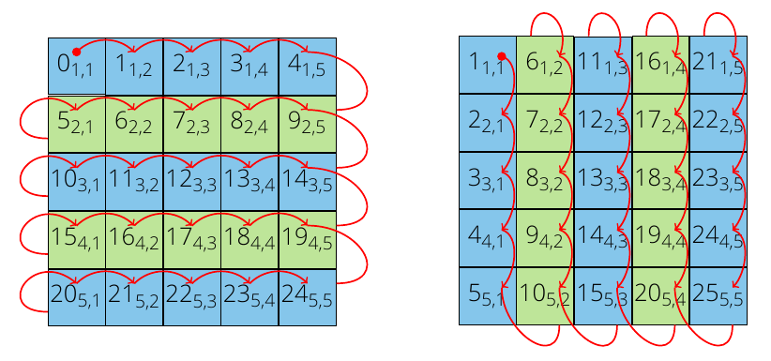
Arrays in C&Fortran
A is n=5,m=5
double A[5][5]
for(i=0;i<n;++i){
for(j=0;j<m;++j){
A[i][j]=(double)i*j
}
}
Real(kind=8) :: A(5,5)
Do j=1,n
do i=1,m
A(i,j)=real(i,8)*j
end do
end do

Slide 94
Further reading
Designing and Building Parallel Programs Ian Foster.
http://www-unix.mcs.anl.gov/dbpp/
Introduction to Parallel Computing Ananth Grama, Anshul Gupta, George Karypis, Vipin Kumar.
http://www-users.cs.umn.edu/~karypis/parbook/
Introduction to Parallel Computing
https://computing.llnl.gov/tutorials/parallel_comp

Slide 95
And more…
Michael Quinn, Parallel Programming in C with MPI and OpenMP
Georg Hager and Gerhard Wellein, Introduction to High Performance Computing for Scientists and Engineers
Also:
http://openmp.org/wp/openmp-specifications/
http://www.mcs.anl.gov/research/projects/mpi/

Slide 96
Paradigms
A variety of concepts:
Threads
Shared memory
Message passing
Distributed data
Remote Memory Access
…

Slide 97
Shared vs Distributed Memory
Shared memory:
Single address memory space. All processors have access to a pool of shared memory.
P
P
P
P
P
BUS
Memory
P
P
P
P
P
Distributed memory: each processor has its own local memory. Must do message passing to exchange data between processors
M
M
M
M
M
Network

